Slide 1
Local
Folk Art Birds

Slide 2
Folk Art:
Handmade art representing the traditions of a certain area. Usually created by untrained or anonymous artists.

Slide 3
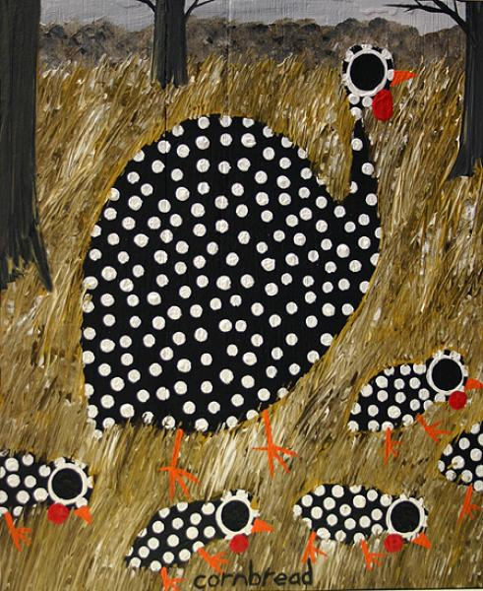
Art by John “Cornbread” Anderson

Slide 4
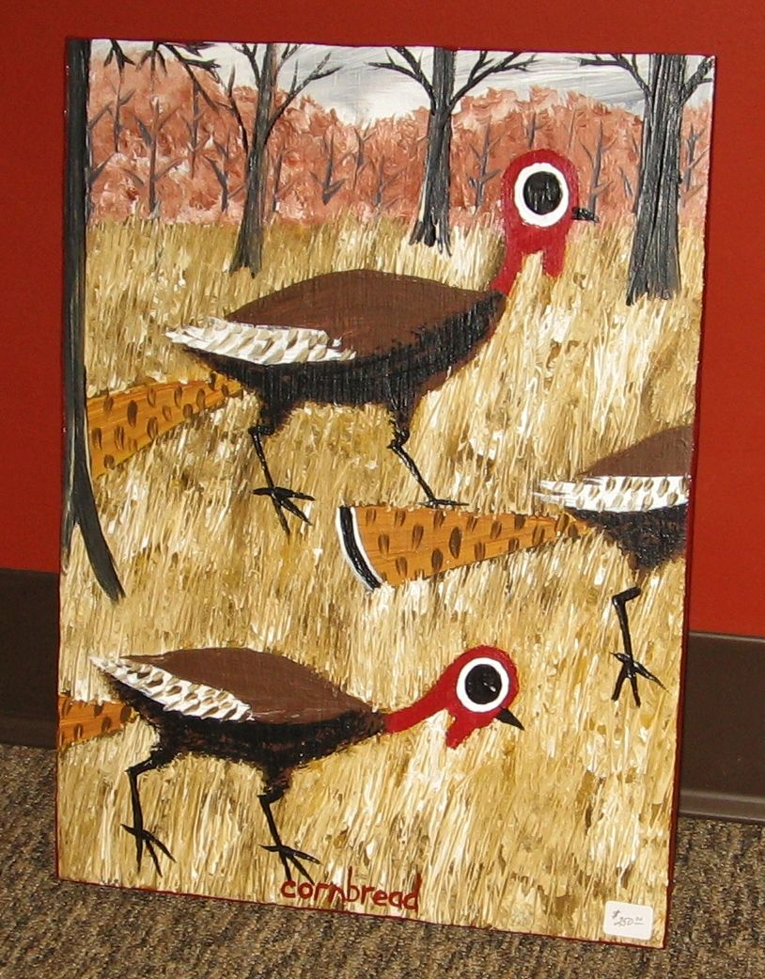
Art by John “Cornbread” Anderson

Slide 5
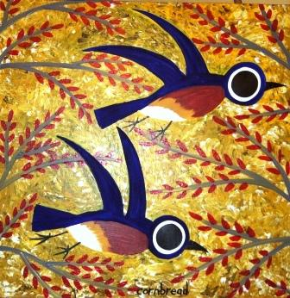
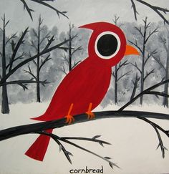
Art by John “Cornbread”
Anderson

Slide 6
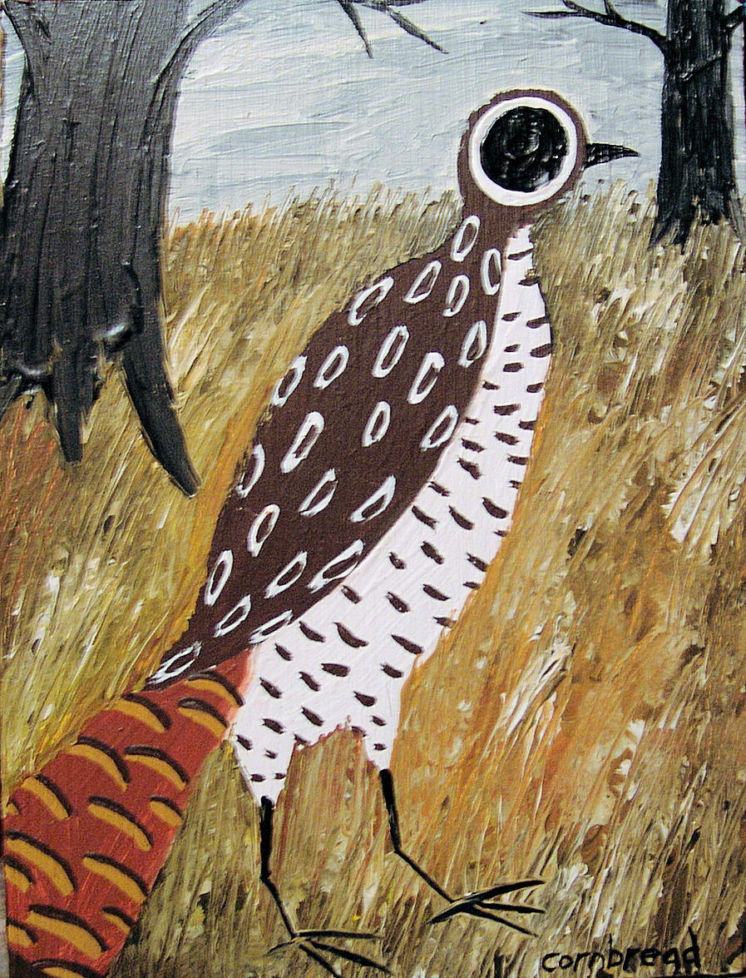
Art by John “Cornbread” Anderson

Slide 7
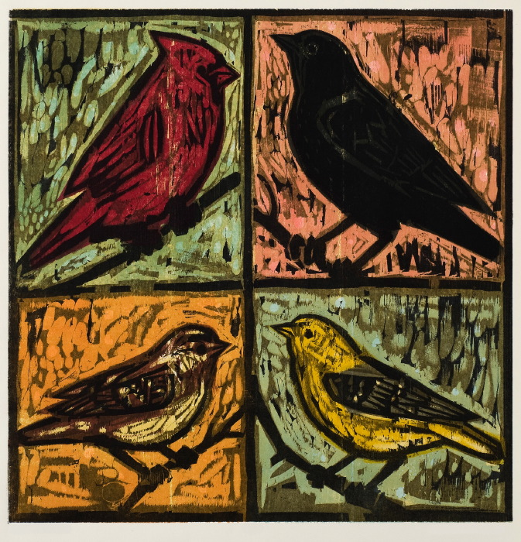
Art by Kent Ambler

Slide 8
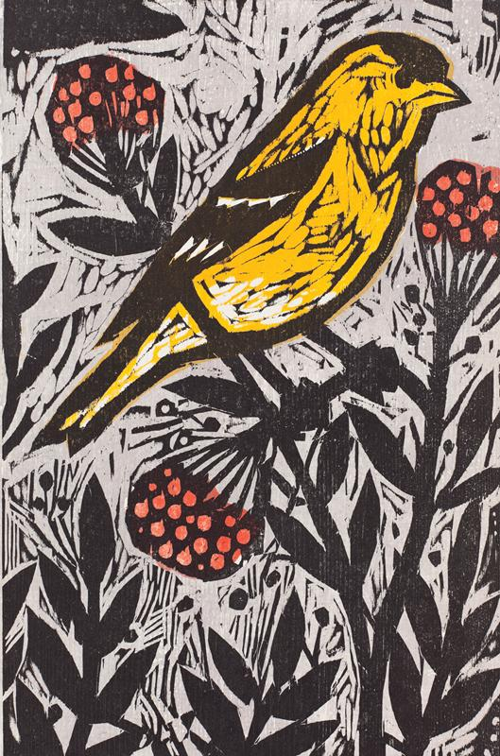
Art by Kent Ambler

Slide 9
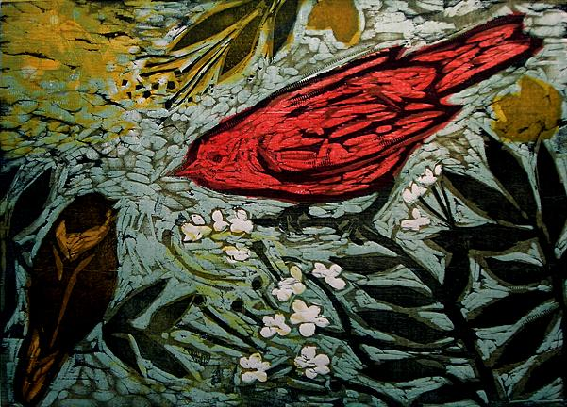
Art by Kent Ambler

Slide 10
Think about it!
What do you notice about the shapes of the birds?
What do you notice about the patterns? About the textures?
How can you create a bird with pencil and paper using these findings?

